Slide 1
Open an Account
Open an Account
PERSONAL ACCOUNTS (https://www.colfinancial.com/ape/Final2/home/open_an_account.asp)
1. Choose your account type ››
COL STARTER
Minimum Investment: P5,000
An entry-level account suitable for long term investing. Provides access to basic research reports, standard market information, and end-of-day charting data.
COL PLUS
Minimum Investment: P25,000
For active traders. Provides streaming quotes, comprehensive research reports and live chart data with some customizable features.
COL PREMIUM
Minimum Investment: P1 Million
For the premier investor. Provides access to all available features and a personal relationship manager dedicated to assist you.

Slide 2
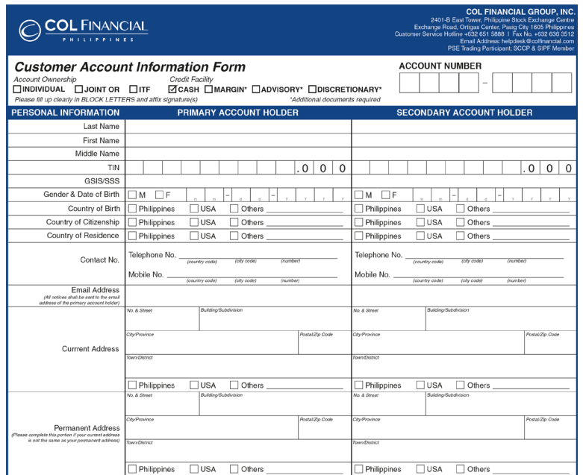
2. Fill out our application form ››
OPTION 1:
1. ONLINE APPLICATION FORM ››
1.Fill out our online application form. Note: Tax Identification Number (TIN) is required.
Sample

Slide 3
Duly fill out all forms:
1. Customer Account Information Form (CAIF) 2. Online Securities Trading Agreement (OSTA)
3. Specimen Signature Cards – 2
4. Sign on the signature fields.
2. Print out the application form when done.
3. Sign on the signature fields.

Slide 4
3. Prepare additional requirements ››
FILIPINO CITIZENS
Photocopy of one (1) valid government issued ID Photo and signature must be clear
Billing Statement - Recent, no later than 3 months past
RESIDENT FOREIGN CITIZENS
Photocopy of one (1) valid government issued ID Photo and signature must be clear
Alien Certificate of Registration (ACR) or Work Permit from DOLE
Billing Statement - Recent, no later than 3 months past
NON-RESIDENT FOREIGN CITIZENS
Authentication of a photocopy of one (1) valid passport Photo and signature must be clear
Proof of Income
Billing Statement - Recent, no later than 3 months past

Slide 5
IN-TRUST-FOR (ITF) ACCOUNTS
Photocopy of one (1) valid government issued ID of the parent Photo and signature must be clear
Birth Certificate of the minor applicant
Duly-signed ITF Supplementary Agreement Download here ››
Billing Statement - Recent, no later than 3 months past

Slide 6
4. Submit forms and requirements ››
COL BUSINESS CENTER
2403-B East Tower, PSE Centre Exchange Road, Artigas Center, Pasig City, Philippines 1605
Note:
i. Please submit your scan copy of your requirement to one of the col financial officer to make sure your application form is correct before you send the original copy to col financial office.
ii. Once all requirements are received, a sale officer will contact you via call or email to inform you of your COL Account No. and status of your application.
iii. Make sure you have a Phil. Bank Account.

Slide 7
5. Fund your account ››
ONLINE BILLS PAYMENT
Bank of the Philippine Islands (BPI)
Banco de Oro (BDO)
Metro bank
Asia United Bank
OVER-THE-COUNTER BILLS PAYMENT
Bank of the Philippine Islands (BPI)
Banco de Oro (BDO)
Metrobank
Asia United Bank
OVERSEAS REMITTANCE
Banco de Oro (BDO)
IREMIT
*All checks must be payable to COL FINANCIAL GROUP, INC. Please include your Name and COL Account No. at the back.

Slide 8
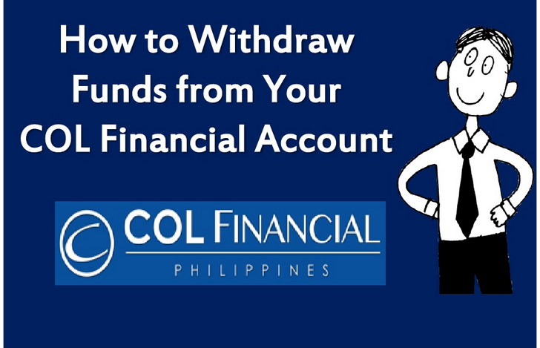

Slide 9
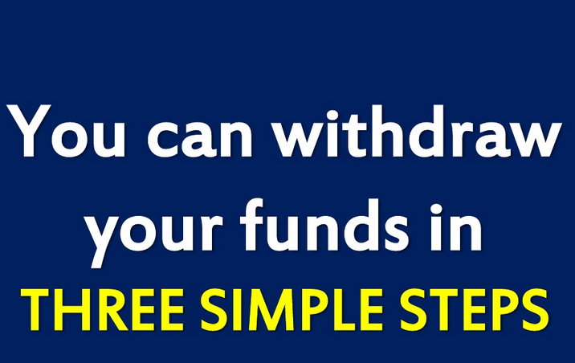

Slide 10
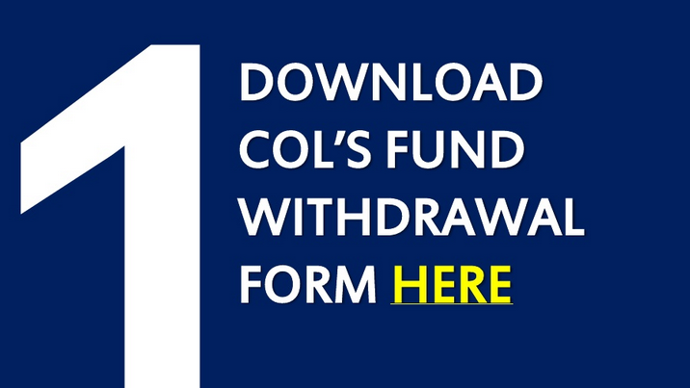

Slide 11
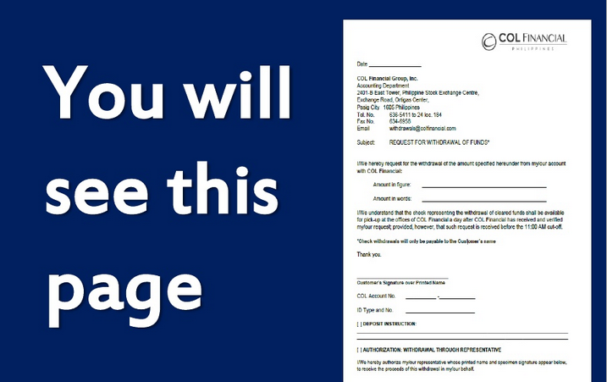

Slide 12
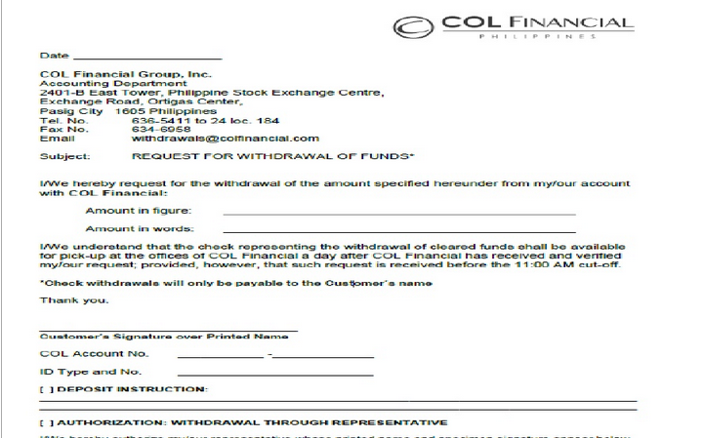

Slide 13


Slide 14
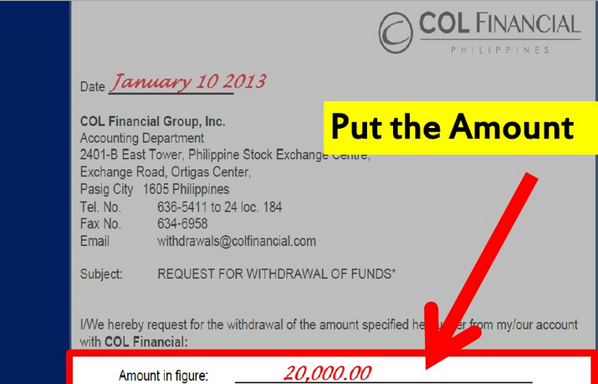

Slide 15
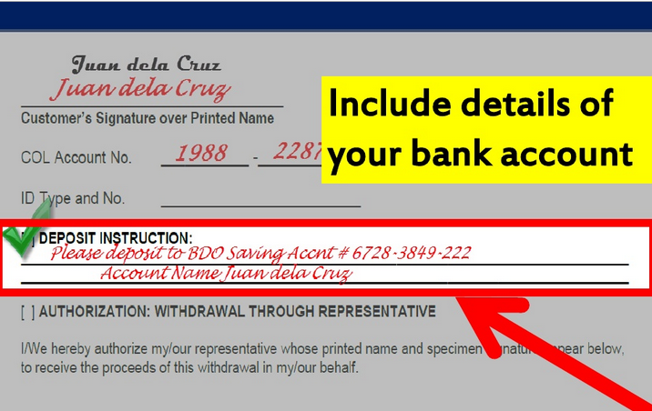

Slide 16
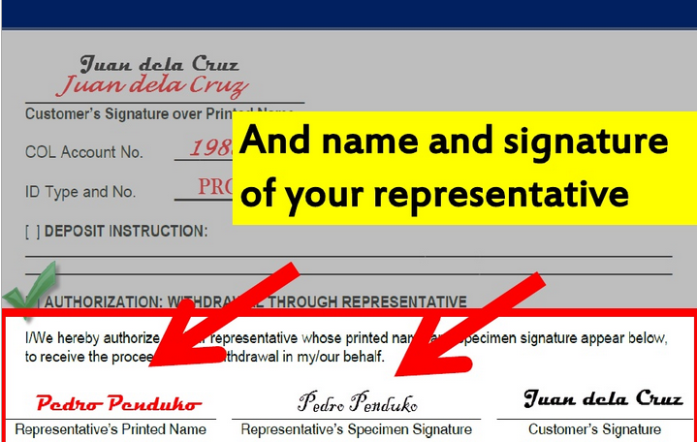

Slide 17
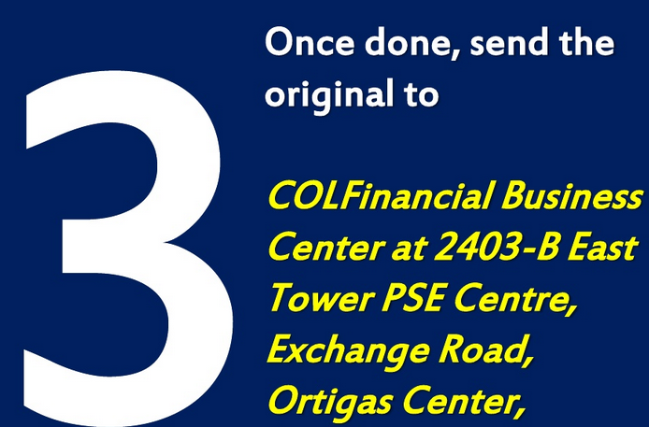

Slide 18
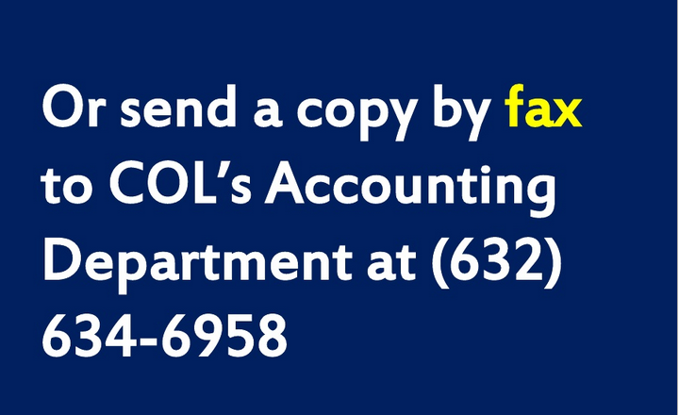

Slide 19


Slide 20


Slide 21
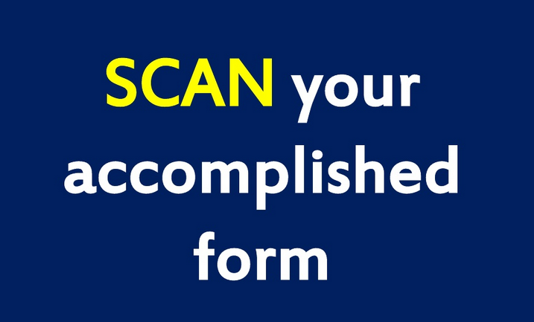

Slide 22
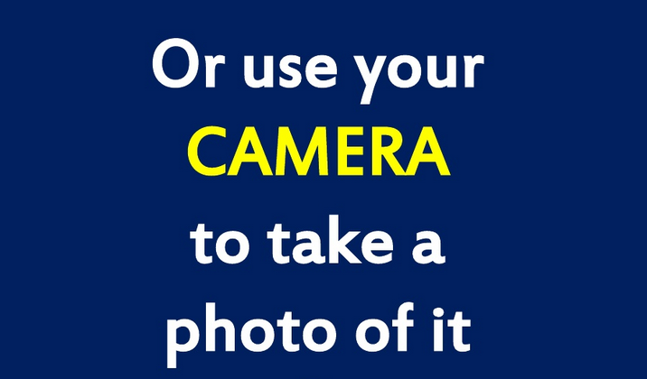

Slide 23


Slide 24
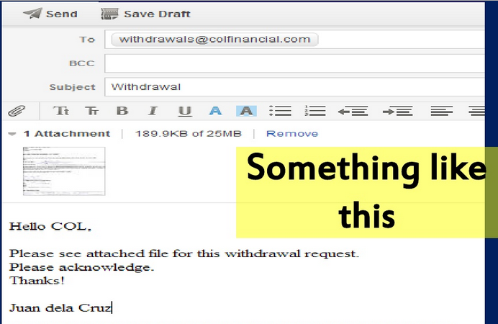

Slide 25


Slide 26
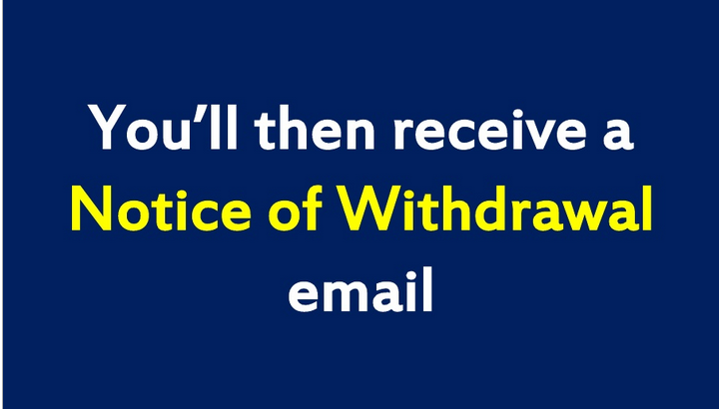

Slide 27
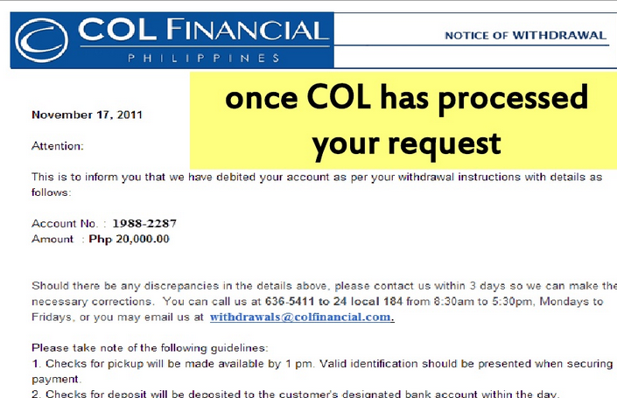

Slide 28
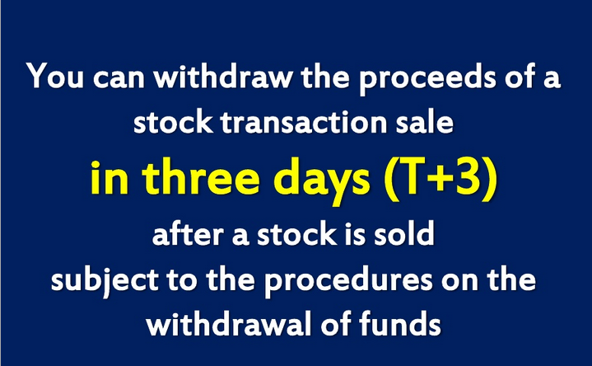

Slide 29
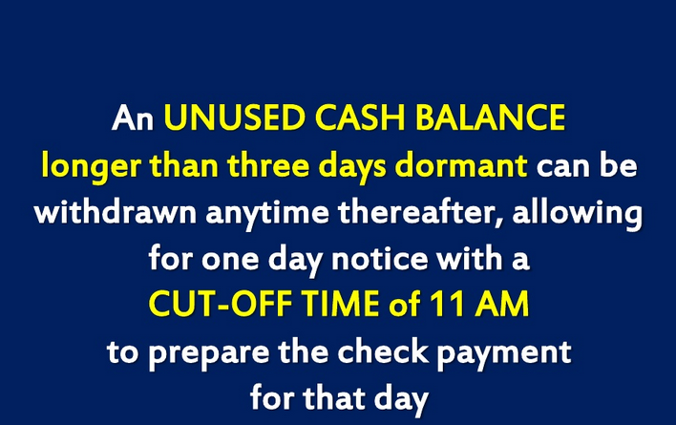

Slide 30


Slide 31


